Slide 1

Capstone project
Cheryl berger • Lucien Roberts • martha richardson

Slide 2
Agenda
Topic Selection
Data Exploration
Objectives
Machine Learning Model
Data Pre-Processing
Feature Selection & Engineering
Model Assessment & Selection (Limitations & Benefits)
Database Selection & ERD
Database Interface Description
Illustrations
Join using dbase language
Connection String (SQL)
Analysis
Initial Outcomes – Linear Regression
Model Outcome – Random Forest Classification
Discussion
Additional Machine Learning Models

Slide 3


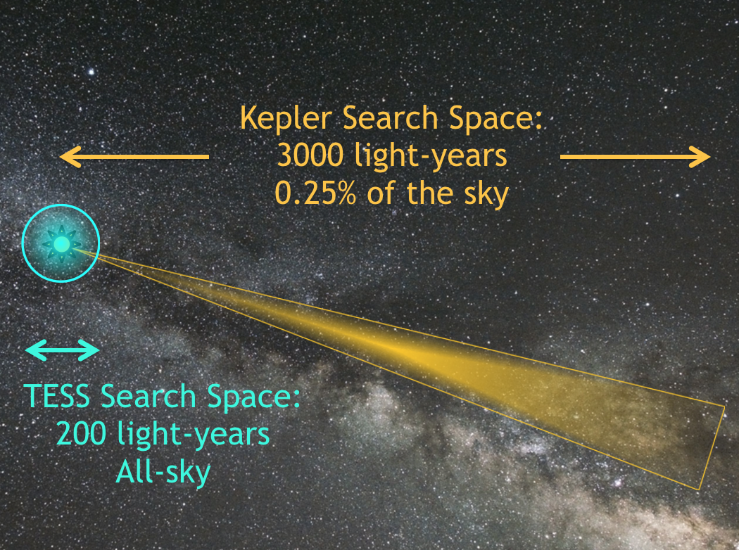



Topics considered
Some datasets were too small
Some datasets were too big
We found one that was just right!

Slide 4


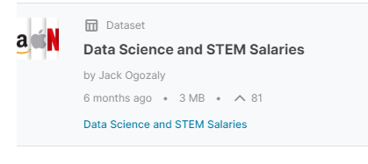

Our project
Kaggle Data Science and STEM Salaries Dataset

Slide 5
Why choose this dataset?
It is extremely relevant to all of us
The dataset pretty large, needs some pre-processing, but is not so big that we have trouble storing and sharing it
There are several columns in the data we can target for different types of analysis

Slide 6
Description of dataset
29 Columns and 62,642 rows
Data Science and STEM Salaries from June 7, 2017 to August 17, 2021
https://www.kaggle.com/datasets/jackogozaly/data-science-and-stem-salaries
Demographics – Gender, race, location, education level
Salary Details – Base and total annual salaries, bonus &/or stock option values
Employment - Company name, years of experience and years at employer

Slide 7
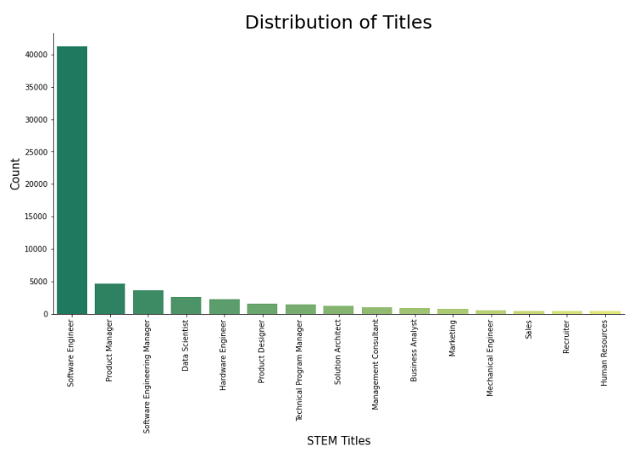
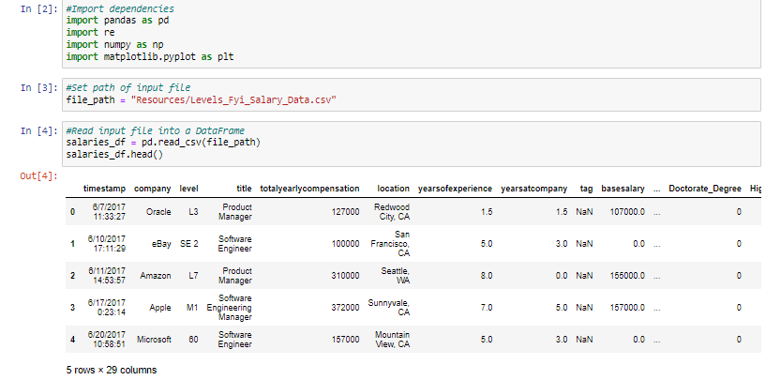
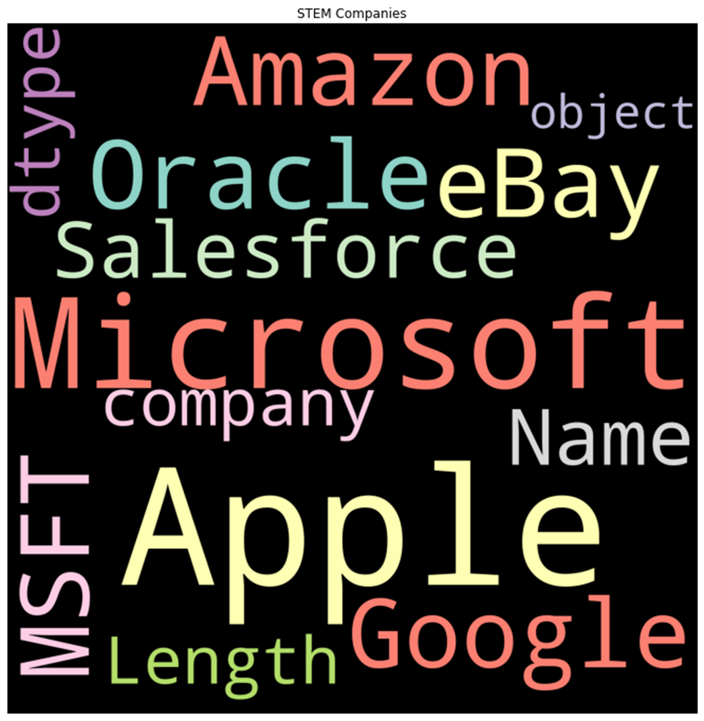
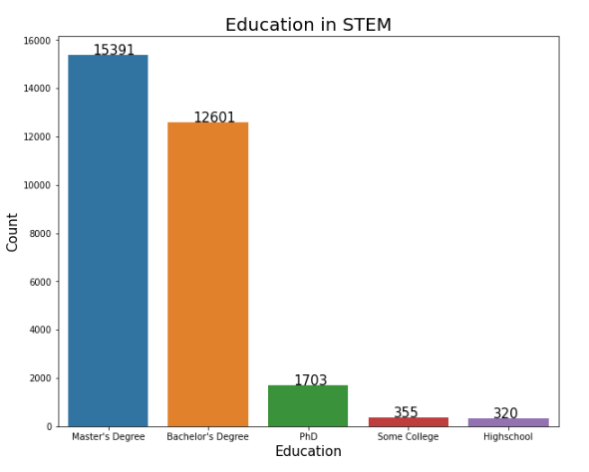
A “SnEAK PEAK” AT THE DATA

Slide 8
OBJECTIVES OF OUR PROJECT
Discover what features and model make the best predictions for salaries of STEM Professionals and Data Scientists
Explore the data and visualize contents, perform data cleaning, engineer the features, and pre-process the dataset for machine learning
Identify the best predictive model and select the user input features.
Develop the ERD and connect a SQL Database to the model
Present our results via an interactive table similar to the UFO or Bellybutton projects

Slide 9
Data Exploration
Explore the data for predictive features
Note the continuous vs categorical values
Evaluate the distribution of the data for various features
Identify Opportunities for data cleaning
Capstone Project - Tableau Vizs

Slide 10
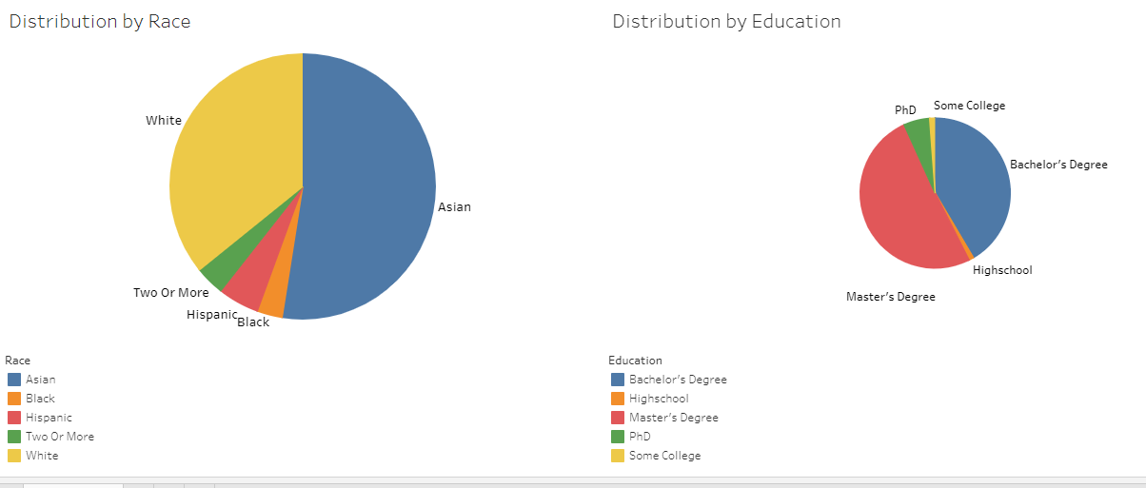
Distribution of DEMOGRAPHIC FEATURES

Slide 11
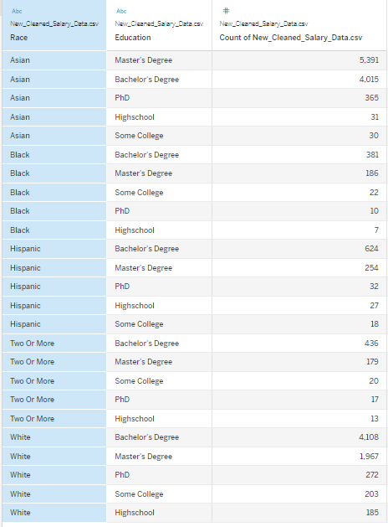
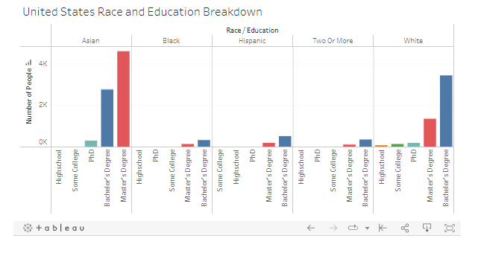
DISTRIBUTION OF EDUCATION BY RACE in THE US

Slide 12
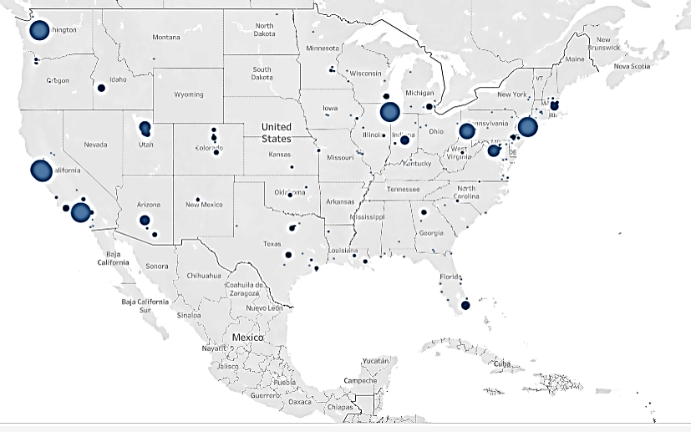
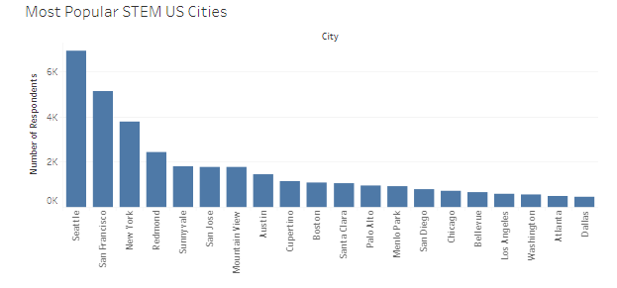
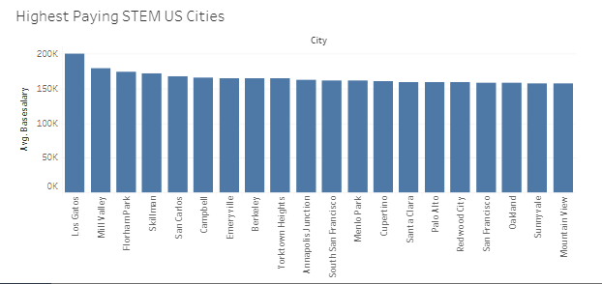
LOCATION, LOCATION, LOCATION!!
https://public.tableau.com/app/profile/lucien.roberts/viz/Capstone-2_16503935278710/US

Slide 13
Data exploration steps
We intend to clean/process the data columns in the following ways. More details are available in the README.md file on GitHub
Keep as is: yearsofexperience, yearsatcompany, rowNumber
Numeric fields to investigate and maybe keep: totalyearlycompensation, basesalary, stockgrantvalue, bonus.
Categorical fields to keep and possibly bucket: company, title, location
Boolean fields to keep (possibly as is, maybe collapse and use encoding instead): Masters_Degree, Bachelors_Degree, Doctorate_Degree, Highschool, Some_College, Race_Asian, Race_White, Race_Two_Or_More, Race_Black, Race_Hispanic
Fields to drop: timestamp, level, tag, otherdetails, cityid, Race, Education
Fields to keep and mull over missing/mysterious values: gender, dmaid

Slide 14
Proposed machine learning model
We plan to deploy a machine learning model that can be used to predict salaries for data scientists and STEM professionals.
Linear regression is the best model to choose with a continuous variable like salary.
With our cleaned and pre-processed data, we will divide the data into training and testing sets and then train and test our model
The salary prediction by years of service example in Module 17.2.3 was the starting point for our coding
We will explore which features are the best predictors, and possibly look into other Scikit-learn linear regression models

Slide 15
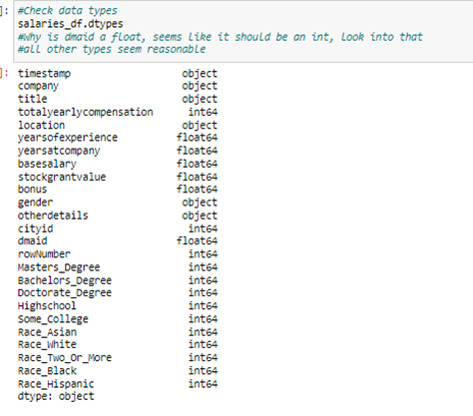
DATA CLEANING STEPS – RounD 1
Reduced noisy data:
Checking for usable DataTypes
Transform the location column
Performing Outliers Analysis
Other Data Cleaning
Dropped 29 duplicate rows, 0 duplicate columns
Dropped unwanted columns
Removed null values
gender 19540
otherdetails 22505
Dropped 5 rows where company is NaN missing rows (data now has 62,637 rows)
Convert timestamp field from object to datetime
Clean-up erroneous data values in location and gender columns
The total number of rows with data in the education columns is 30472 out of 62637 rows
The total number of rows with data in the race columns is 22426 out of 62637 row
Identified and corrected additional typographical and formatting errors in the data

Slide 16
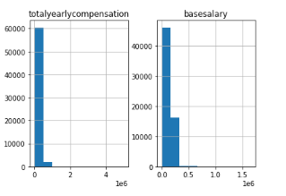
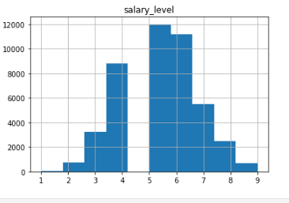
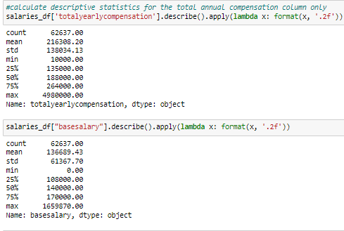
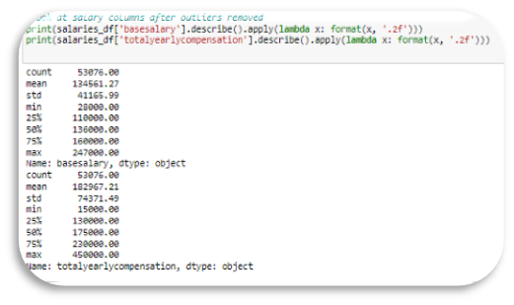
Noisy & UNWANTED DATA
Distribution of Total & Base Salary BEFORE Cleaning

Slide 17
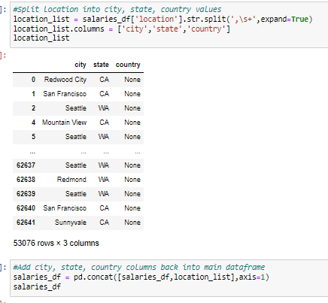
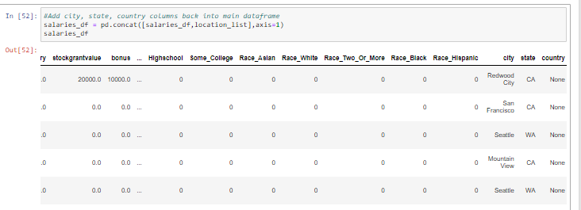
SPLIT the LOCATION COLUMN
The feature “location” is an object containing a string list of city and state
This feature will be split and added back to the data for review of regional contributions to the output

Slide 18
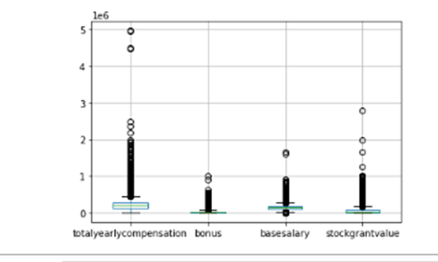
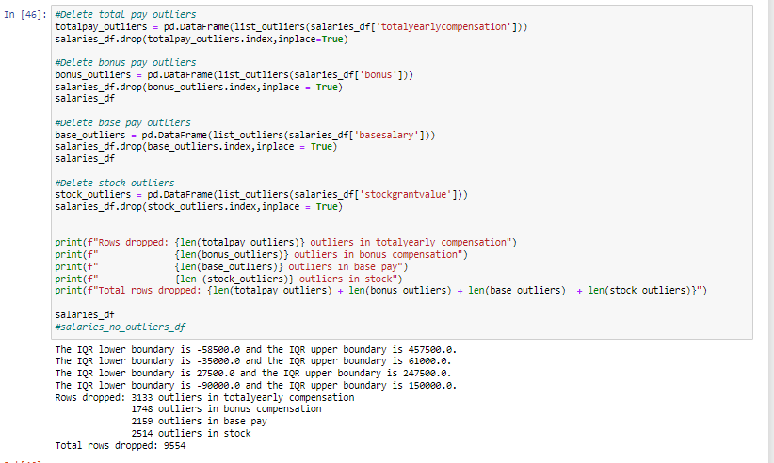
ANALYZE DATA FOR OUTLIERS
There are 3133 (5.00%) outliers in the totalyearlycompensation column
There are 2604 (4.16%) outliers in the bonus column
There are 2155 (3.44%) outliers in the basesalary column
There are 4683 (7.48%) outliers in the stockgrantvalue column
Drop Outliers from Dataset, 53076 rows × 25 columns
Write the clean data to file
Resources/Cleaned_Salary_Data.csv

Slide 19
Bucketed values company, title, city, state, country, base salary

Slide 20
EXPLORING THE DATA FOR PREDICTIVE FEATURES

Slide 21
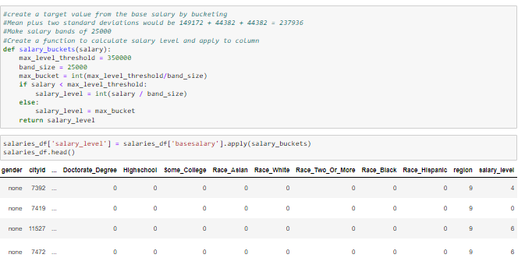
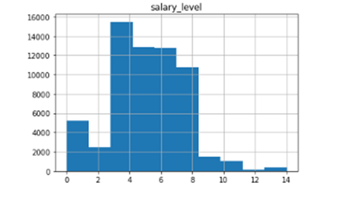
FEATURE ENGINEERING – Salary level
For rows where basesalary = 0, set equal to totalyearlycompensation
create a target value from the base salary by bucketing
#Mean plus two standard deviations would be 149172 + 44382 + 44382 = 237936
#Make salary bands of 25000
#

Slide 22
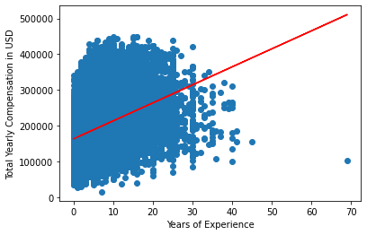
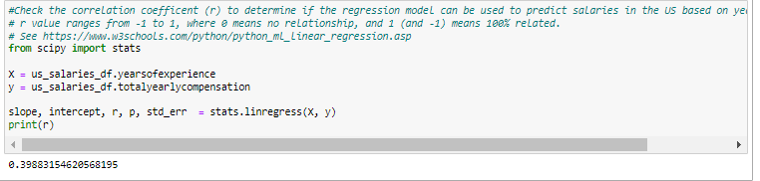
Linear RegRession
Resources/US_Salary_Cleaned.csv
The slope = [5040.09]
The y-intercept = 163190.93
r = 0.398
r = 0.40 (r²=0.18) is a weak correlation, this model could use improvement.
Cleaning_Data.ipynb
See https://www.w3schools.com/python/python_ml_linear_regression.asp

Slide 23
Other Regression FEATURES EXPLORED
Title
Gender

Slide 25
SUPERVISED LEARNING – RANDOM FOREST CLASSIFICATION
CLASSIFICATION OF THE DATA
DROPPING OUTPUT COLUMS
ONE HOT ENCODING
SCALE USING STANDARD SCALER
SPLIT INTO TEST/TRAINING DATASETS
Training Data Shape (46977 rows, 38 columns)
Test Data (15660 rows, 38 columns)
Preprocessing for Other Models.ipynb

Slide 26

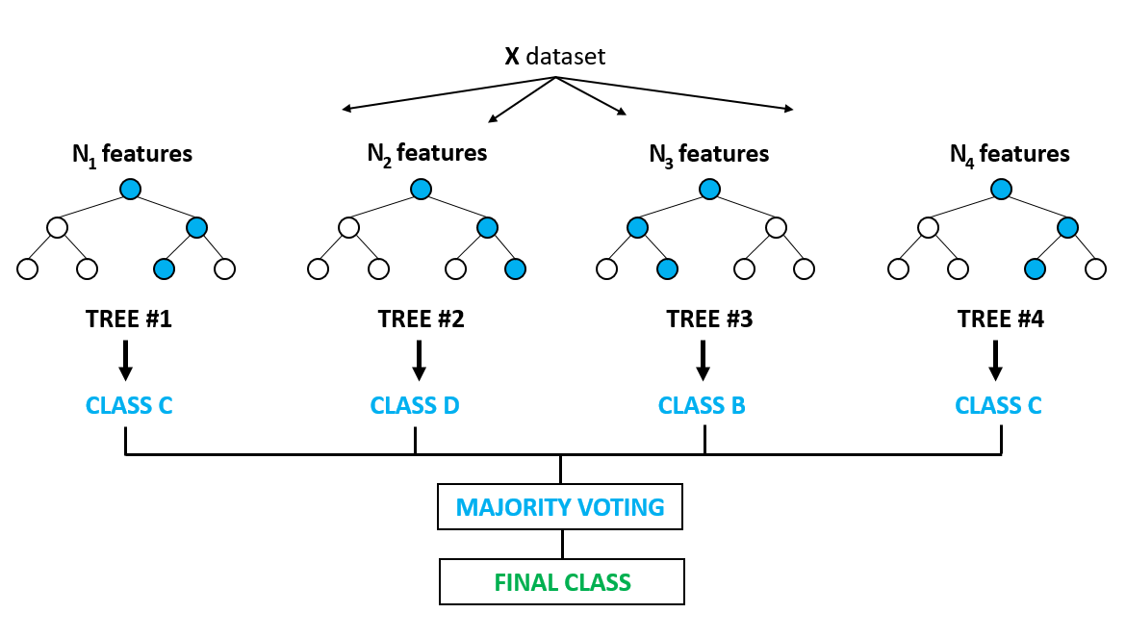
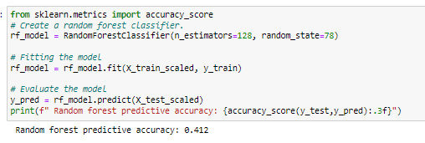
RANDOM FOREST MODEL (RFM) – ALL FEATURES

Slide 27
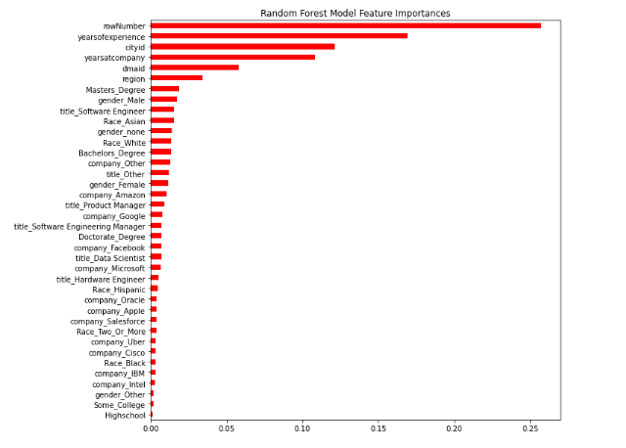
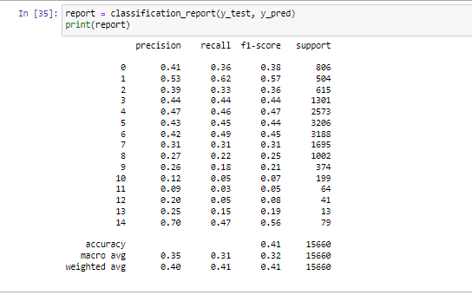
OUTCOMES & IMPORTANCES – RFM ALL FEATURES
Import Dependencies
from sklearn.metrics import accuracy_score, confusion_matrix, classification_report
Predictive Accuracy = 0.41
F1 Score = 0.41

Slide 28
FINAL MODEL SELECTION
CLASSIFICATION OF THE DATA
DROP OUTPUT COLUMS
PERFORM ONE HOT ENCODING
SCALE USING STANDARD SCALER
SPLIT INTO TEST/TRAINING DATASETS
Training Data Shape (46977 rows, 38 columns)
Test Data (15660 rows, 38 columns)

Slide 29
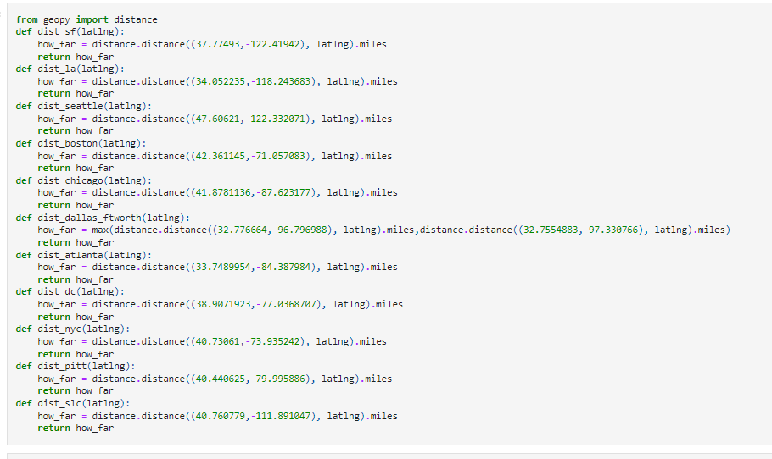
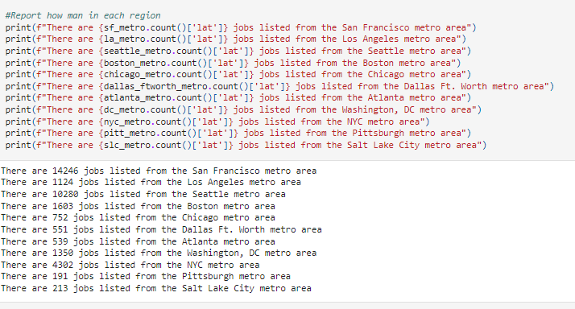
FEATURE ENGINEERING - REGION

Slide 30
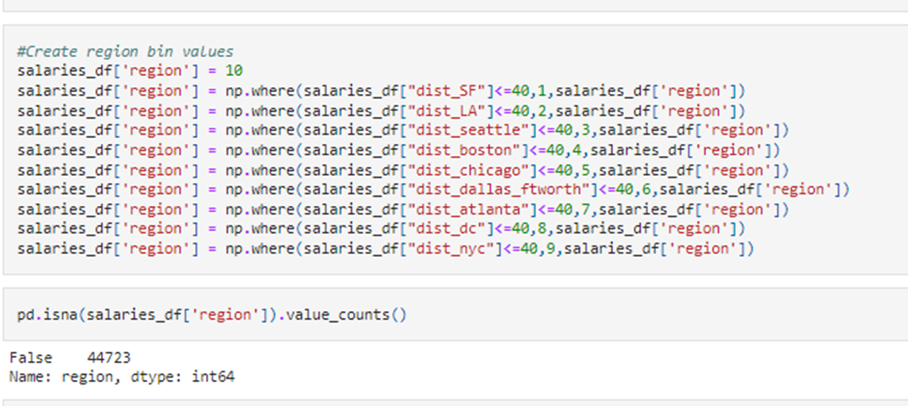
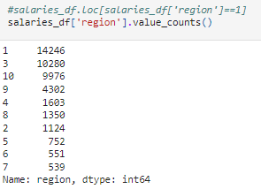
FEATURE ENGINEERING - REGION

Slide 31
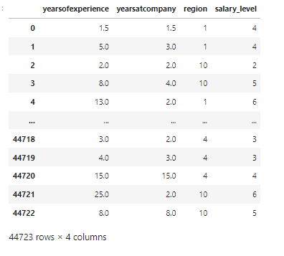
FINAL DATA PREpARATION
Load the Preprocessed data
Resources/US_Salary_Preprocessed_new_regions.csv (44723 rows × 29 columns)
Drop features that don't contribute much to model: company, job title, gender, race, and education, 'dmaid','cityid','rowNumber','timestamp
Final DataFrame (salaries_df) contains Years of Experience, Years at company, Region and Salary Level
The dataset now has 44723 rows but only 4 columns
DONT FOGET:
# Remove output from features data
y = salaries_df.salary_level
X = salaries_df.drop(columns=['salary_level'])

Slide 32
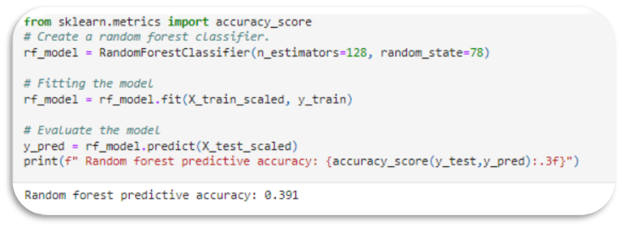
RANDOM FOREST MODEL – 3 FEATURES
Training Data Shape = 33,542 rows, 3 columns
Test Data Shape = 11,181 rows, 3 columns

Slide 33
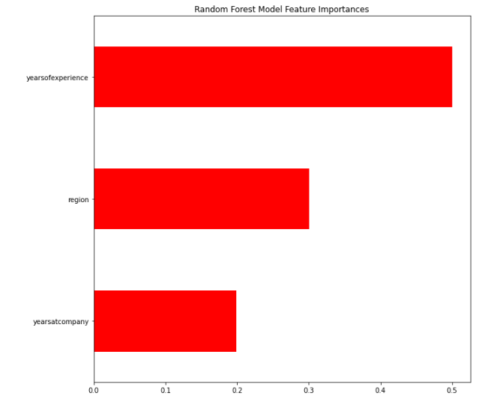
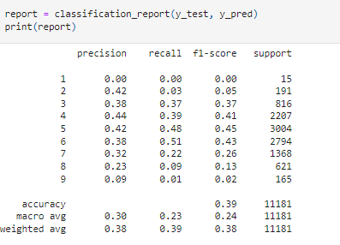
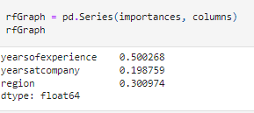
OUTCOMES & IMPORTANCES – RFM 3 FEATURES
Predictive Accuracy = 0.391
F1 Score = 0.39

Slide 34
MACHINE LEARNING MODEL SELECTION
BENEFITS
DRAWBACKS

Slide 35
DataBase SELECTIOn & ERD

Slide 36
Database
We created the schema and imported the original datafile into PostgreSQL with the following alterations:
We removed the other details column from the dataset to import into the database. It contained mostly ancillary and unrelated data, making it completely useless for our machine learning project
The headers for the timestamp, level, and location needed to be changed as they were reserved names in PostGres. The rowNumber value was used as the primary key

Slide 38
For the schema I had to remove the otherdetails column from the dataset to import into the database. It containing mostly ancilary and unrelated data, making it completely useless for our machine learning project. Additionally, the headers for the timestamp, level, and location needed to be changed as they were reserved names in PostGres. The rowNumber value was used as the primary key.

Slide 39

Initial COMMITT

Slide 40
ConCLUSIONS

Slide 41
Discussion

Slide 42
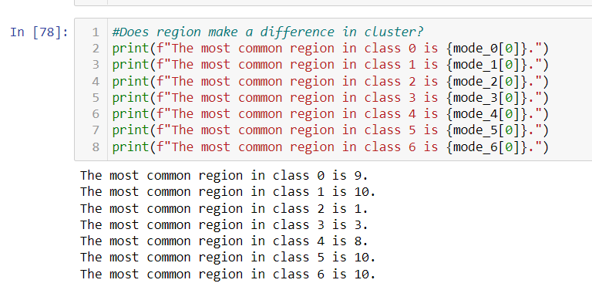
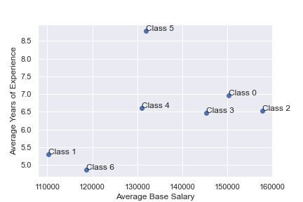
UNSUPERVISED LEARNING
Using the K-means algorithm, an elbow curve and a silhouette analysis, we determined that it was reasonable to divide the data into 7 clusters, which differed by base salary amount, years of experience, and location.
Classes 1 and 6 tend to be low pay, low experience, and outside the top 9 tech areas
Class 4 is medium pay, medium experience, and had many from the DC metro
Class 5 is medium pay and longer experience, mostly outside top 9 tech areas
Classes 0, 2, and 3 tend to be higher paid and medium experience, with many from class 0 in the NYC metro, many from class 2 in the San Francisco metro, and many from Class 3 from the Seattle metro

Slide 43
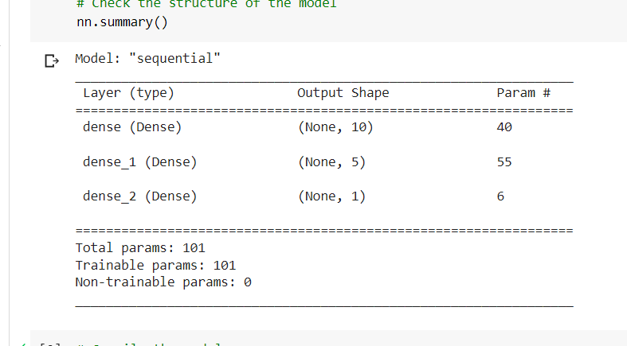
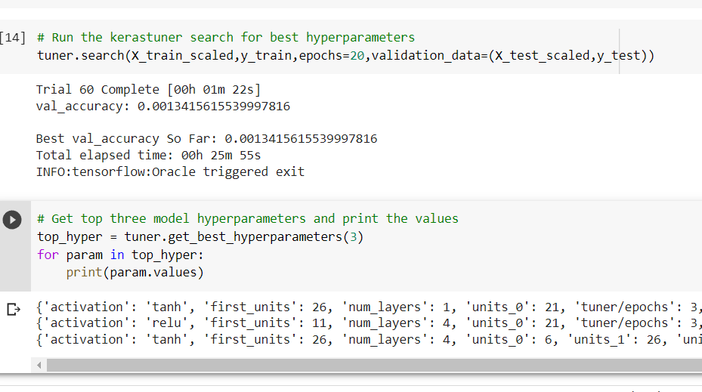
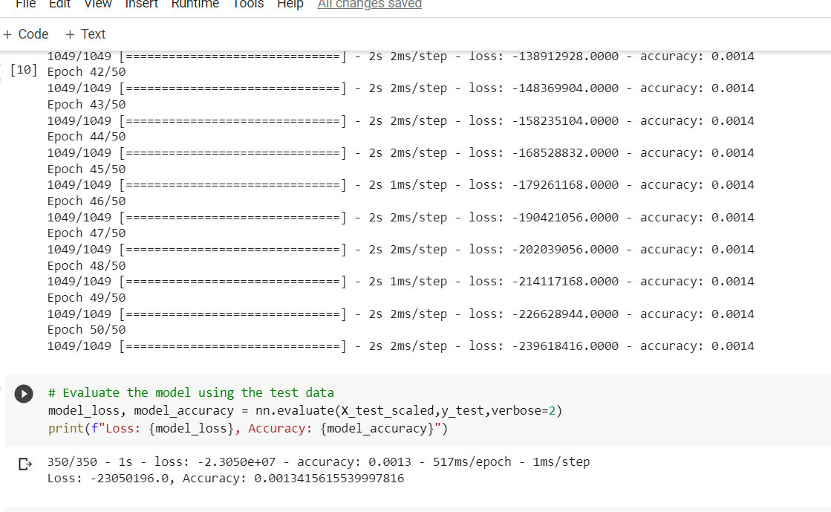
Neural Network model
The neural network model was the least successful model we tried
The highest accuracy we got was 1.4%, even using the Keras tuner to try many different configurations of parameters

Slide 44
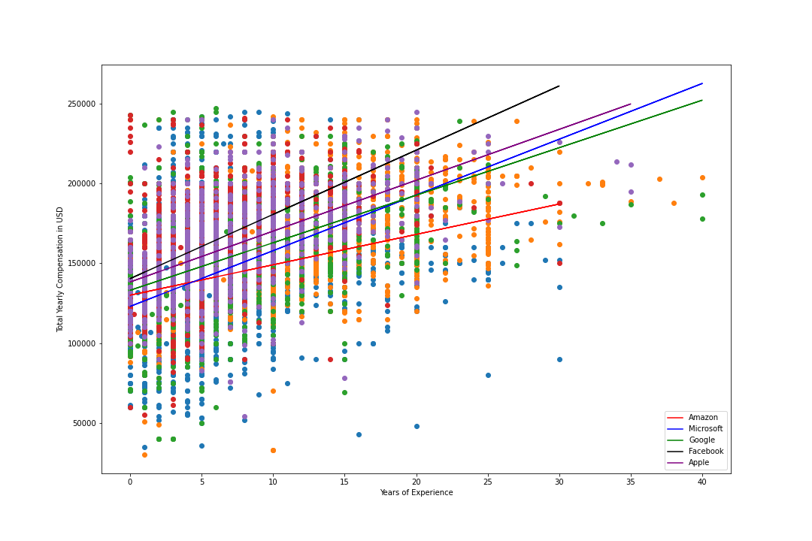
Top 5 companies
The companies that appeared the most in our data were Amazon, Facebook, Microsoft, Google, and Apple, accounting for 35% of all jobs listed
The best accuracy in predicting salaries came from using the linear regression model on each company’s data individually, with Microsoft having a greater than 60% accuracy

Slide 45

QUESTIONS?

Slide 46
What are we going to do with all this data?
Clean and pre-process the data
Test linear regression machine learning models to predict salaries given some input features by the user
Discover what features and model make the best predictions
Look for trends in current data science salaries: by location, job title, gender, race, and educational level
Present our results via an interactive table similar to the UFO or Bellybutton projects

